Slide 1


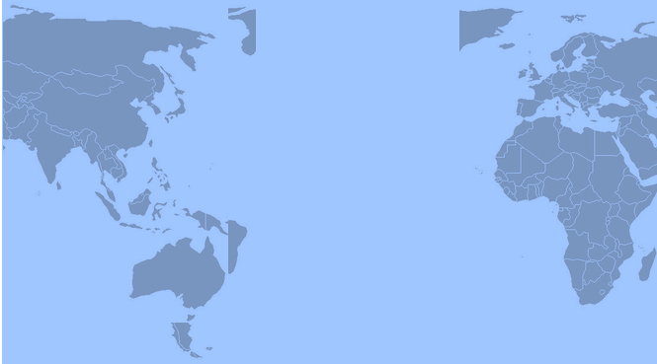



ORGANIZING WORLDWIDE the P&Rs
AGAINST
the measures of CAPITALISM !
WORLD FEDERATION
OF TRADE UNION
27 y 28 february 2019
2°
WORLD CONGRESS
UIS
Bogotá – Colombia – South America
Contact:
quimboix@quimboix.es - http://www.wftucentral.org/?language=en
http://www.pensionistas.info/web/en - pensionados.1@gmail.com

